Slide 1
United Nations

Slide 2
The United Nations (UN) is an intergovernmental organization responsible for maintaining international peace and security, developing friendly relations among nations, achieving international cooperation, and being a center for harmonizing the actions of nations. It is the largest, most familiar, most internationally represented and most powerful intergovernmental organization in the world.

Slide 3
Headquarters | New York City (international territory)
Official languages | Arabic Chinese English French Russian Spanish
Type | Intergovernmental organization
Membership | 193 member states 2 observer states

Slide 4
Leaders
• Secretary‑General | António Guterres
• Deputy Secretary-General | Amina J. Mohammed
• General Assembly President | Tijjani Muhammad-Bande
• Economic and Social Council President | Mona Juul
• Security Council President | Vasily Nebenzya
Establishment
• UN Charter signed | 26 June 1945 (74 years ago)
• Charter entered into force | 24 October 1945 (74 years ago)

Slide 5
Flag Emblem

Slide 6
Goal
the observance of peace and security in the world;
development of friendly relations between peoples;
support for international cooperation and respect for human rights in solving international problems;
to become the center of interaction of nations in achieving these goals.

Slide 7
The un is headquartered on international territory in New York city; other main offices are in Geneva, Nairobi, Vienna and the Hague. The un was established after world war with the aim of preventing future wars, succeeding the ineffective league of nations. On 25 april 1945, 50 governments met in San Francisco for a conference and started drafting the un charter, which was adopted on 25 june 1945 and took effect on 24 october 1945, when the un began operations. pursuant to the charter, the organization's objectives include maintaining international peace and security, protecting human rights, delivering humanitarian aid, promoting sustainable development, and upholding international law. At its founding, the un had 51 member states; there are now 193, representing the vast majority of the world's sovereign states.

Slide 8
The organization's mission to preserve world peace was complicated in its early decades by the cold war between the united states and soviet union and their respective allies. Its missions have consisted primarily of unarmed military observers and lightly armed troops with primarily monitoring, reporting and confidence-building roles. Un membership grew significantly following widespread decolonization beginning in the 1960s. Since then, 80 former colonies have gained independence, including 11 trust territories that had been monitored by the trusteeship council. By the 1970s, the un's budget for economic and social development programmes far outstripped its spending on peacekeeping. After the end of the cold war, the un shifted and expanded its field operations, undertaking a wide variety of complex tasks.

Slide 9
Mikhail Gorbachev, Soviet general secretary, addressing the UN General Assembly in December 1988

Slide 10
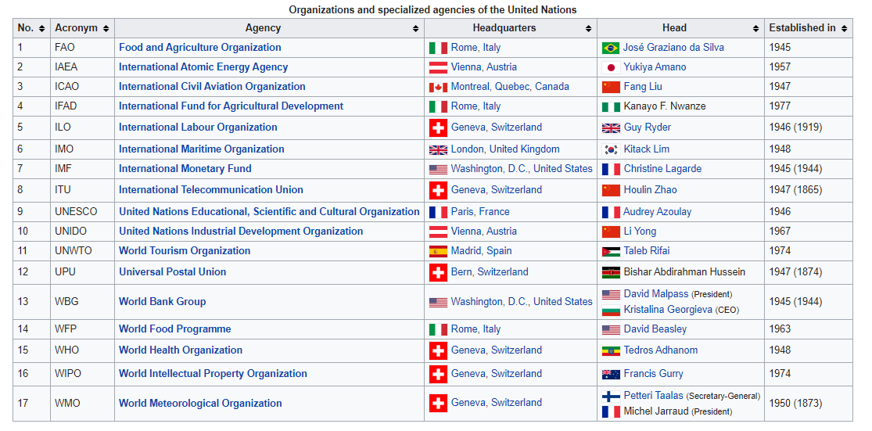

Slide 12
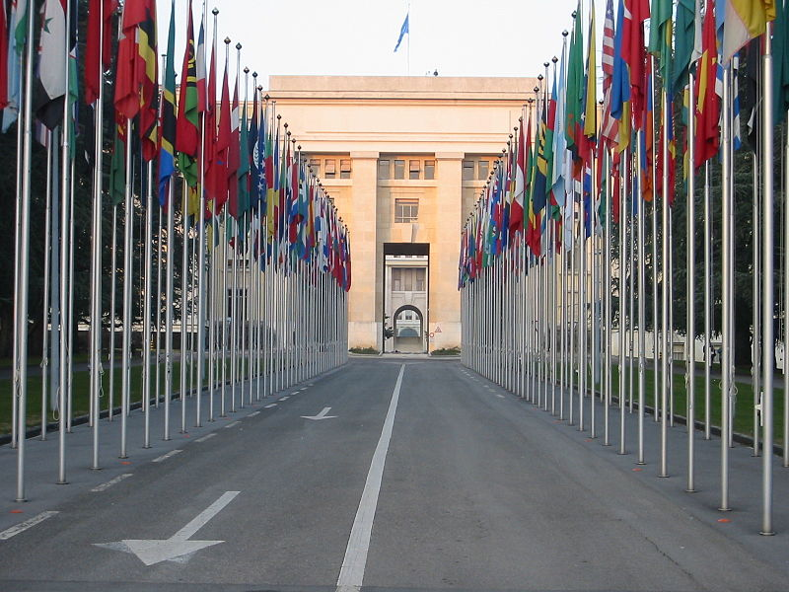
Relatives of the UN, located in Geneva

Slide 13
Kazakhstan And the United Nations
In the history of independent Kazakhstan on march 2, 1992, Kazakhstan is distinguished by the accession of Kazakhstan to the united nations. Our country at the 46th session of the un general assembly became a member not only as a new member of the organization, but also as a state that takes an active position on the most pressing international problems of our time.

Slide 14
International Organizations
the very term international organization is ambiguous. in the conventional sense, an international organization is an institution or structure similar to congress or to a city council; it has a definite set of rules, members, agenda, places and times of meeting. a second meaning of the concept is implied as well. if organization is an arrangement of parts into a unified whole, then there is a no institutional aspect to the phrase international organization. the purpose of organization is conscious coordination of activity; the method of organization is to routinize coordination by such techniques as division of labour and task specialization. coordination can be performed either formally or informally. when coordination is formal, it takes place within official structures and institutional machinery; this is the conventional significance of the term organization in international relations. informal coordination involves an unwritten system of practices in which units of the system assume such roles as those of leader or nonleader. international organization in the second sense refers to informal role differentiation in the world polity. often this second meeting has been called world organization.
in international relations, units that are most powerful take leadership roles; weak units are nonleaders. thus, international organization in the first sense is a dependent variable of world organization, the second interpretation of the term. informal organization is more basic than formal organization; characteristics of international structures are a function of the nature of the international arena. in the subsequent portion of this discussion the term international organization will be used to refer only to the meaning of the term in the conventional sense.
not all organizations are international. historically the types of units in the world political system have changed in form and in number. traditionally, an international organization has been said to exist when many nation-states are linked together structurally. if this criterion were adopted, the study of international organization would date only from the year 1648, when the nation-state system was officially christened in the peace of westphalia. previously there were other basic units – the empire, the city state, the free city, and the dynamic state. a loose definition of international organization would say that it consists of intergovernmental institutions, members of which perceive each other to be basic units of the world polity. any world system may contain international organization.

Slide 15
Question answer the question.
What does the phrase “an international organization” mean in the conventional sense?
What is a no institutional aspect to the phrase “an international organization”?
In what ways can coordination of an international organization be performed? What do they involve?
What criterion is considered to be the most important for the existence of an international organization?
What does an international organization consist of?

Slide 16
At the 47th session of the un general assembly, head of state Nursultan Nazarbayev, speaking about the international policy of Kazakhstan, put forward two important proposals. The first is to launch a one-plus-one fund for un peacekeeping efforts in the good faith of all governments. this formula provides that each state allocates one percent of its defense budget to it and increases it by one percent annually. Thus, in ten years the amount of peacekeeping will increase tenfold. the second proposal is to convene a meeting on interaction and confidence-building measures in Asia (cica). This initiative of the head of state played a significant role in determining the foreign policy of Kazakhstan, both on the part of most countries and the un.

Slide 17
Since 1992, Kazakhstan has not only been accepted as a member of the international community, but has also found its rightful place in it. Kazakhstan's participation in the work of the un system is one of the main directions of multilateral diplomacy of the country, which helps to strengthen the sovereignty and independence of the country, creates favorable international conditions in the socio-political, economic and public spheres. The main goal of this direction is to create in the international arena the strategic interests of Kazakhstan in the field of global and regional security, a just world order and the environment of sustainable development in politics and economy, the harmonization of relations between members of the world community.

Slide 18
The united nations (un) is a universal international, open - type intergovernmental organization with general competence. The united nations was founded in 1945 on the basis of an agreement between the USSR, the united states, great Britain and china. The charter of the united nations was adopted on 26 june 1945 and entered into force on 24 October 1945.

